Slide 1
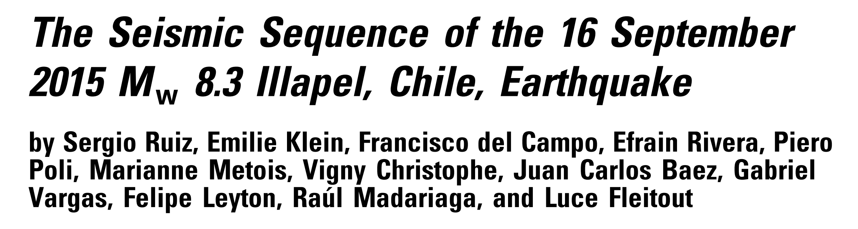
Journal club 2016-09-21
Qingkai Kong

Slide 2
BEFORE THE 2015 ILLAPEL MAINSHOCK

Slide 3
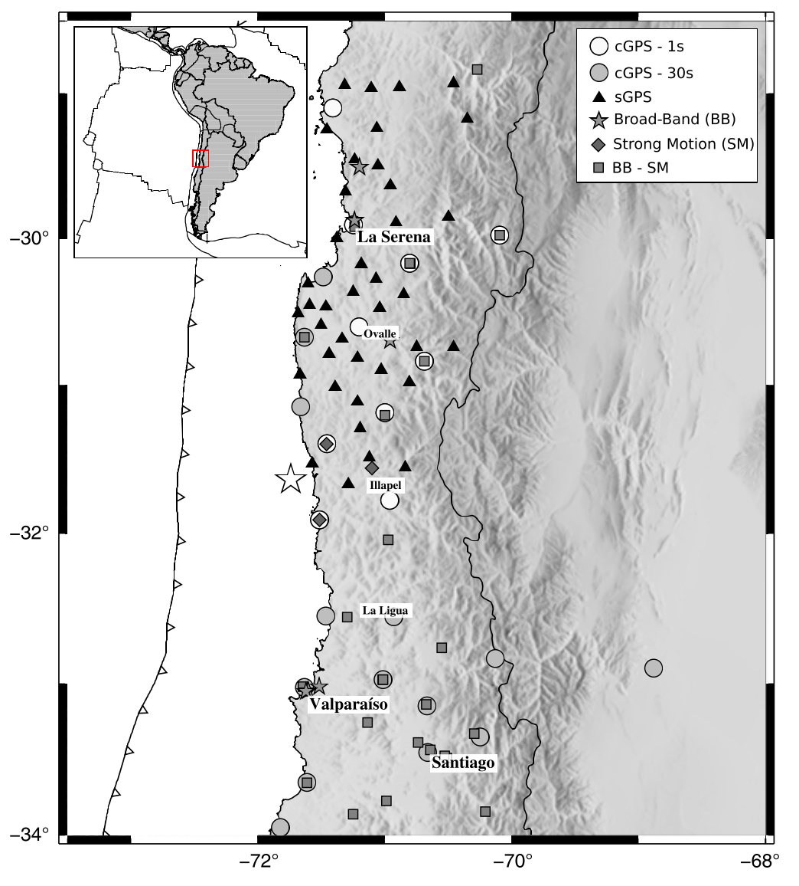
Notes:
Global Positioning System (GPS), Broadband (BB), and strong-motion (SM) stations in the Coquimbo–Valparaiso re- gions of central Chile. Continuous GPS (cGPS)-1 s stations record continuously in time at 1 Hz. cGPS-30 s stations record continu- ously in time every 30 s. sGPS are static survey stations. BB–SM stations are sites where a broadband and an accelerometer are installed, sampling at 100 Hz. SM are sites where strong-motion sensors are located, and BB are the temporary broadband sta- tions deployed one day after of mainshock. The star marks the epicenter of the Illapel earthquake. The color version of this fig- ure is available only in the electronic edition.

Slide 4
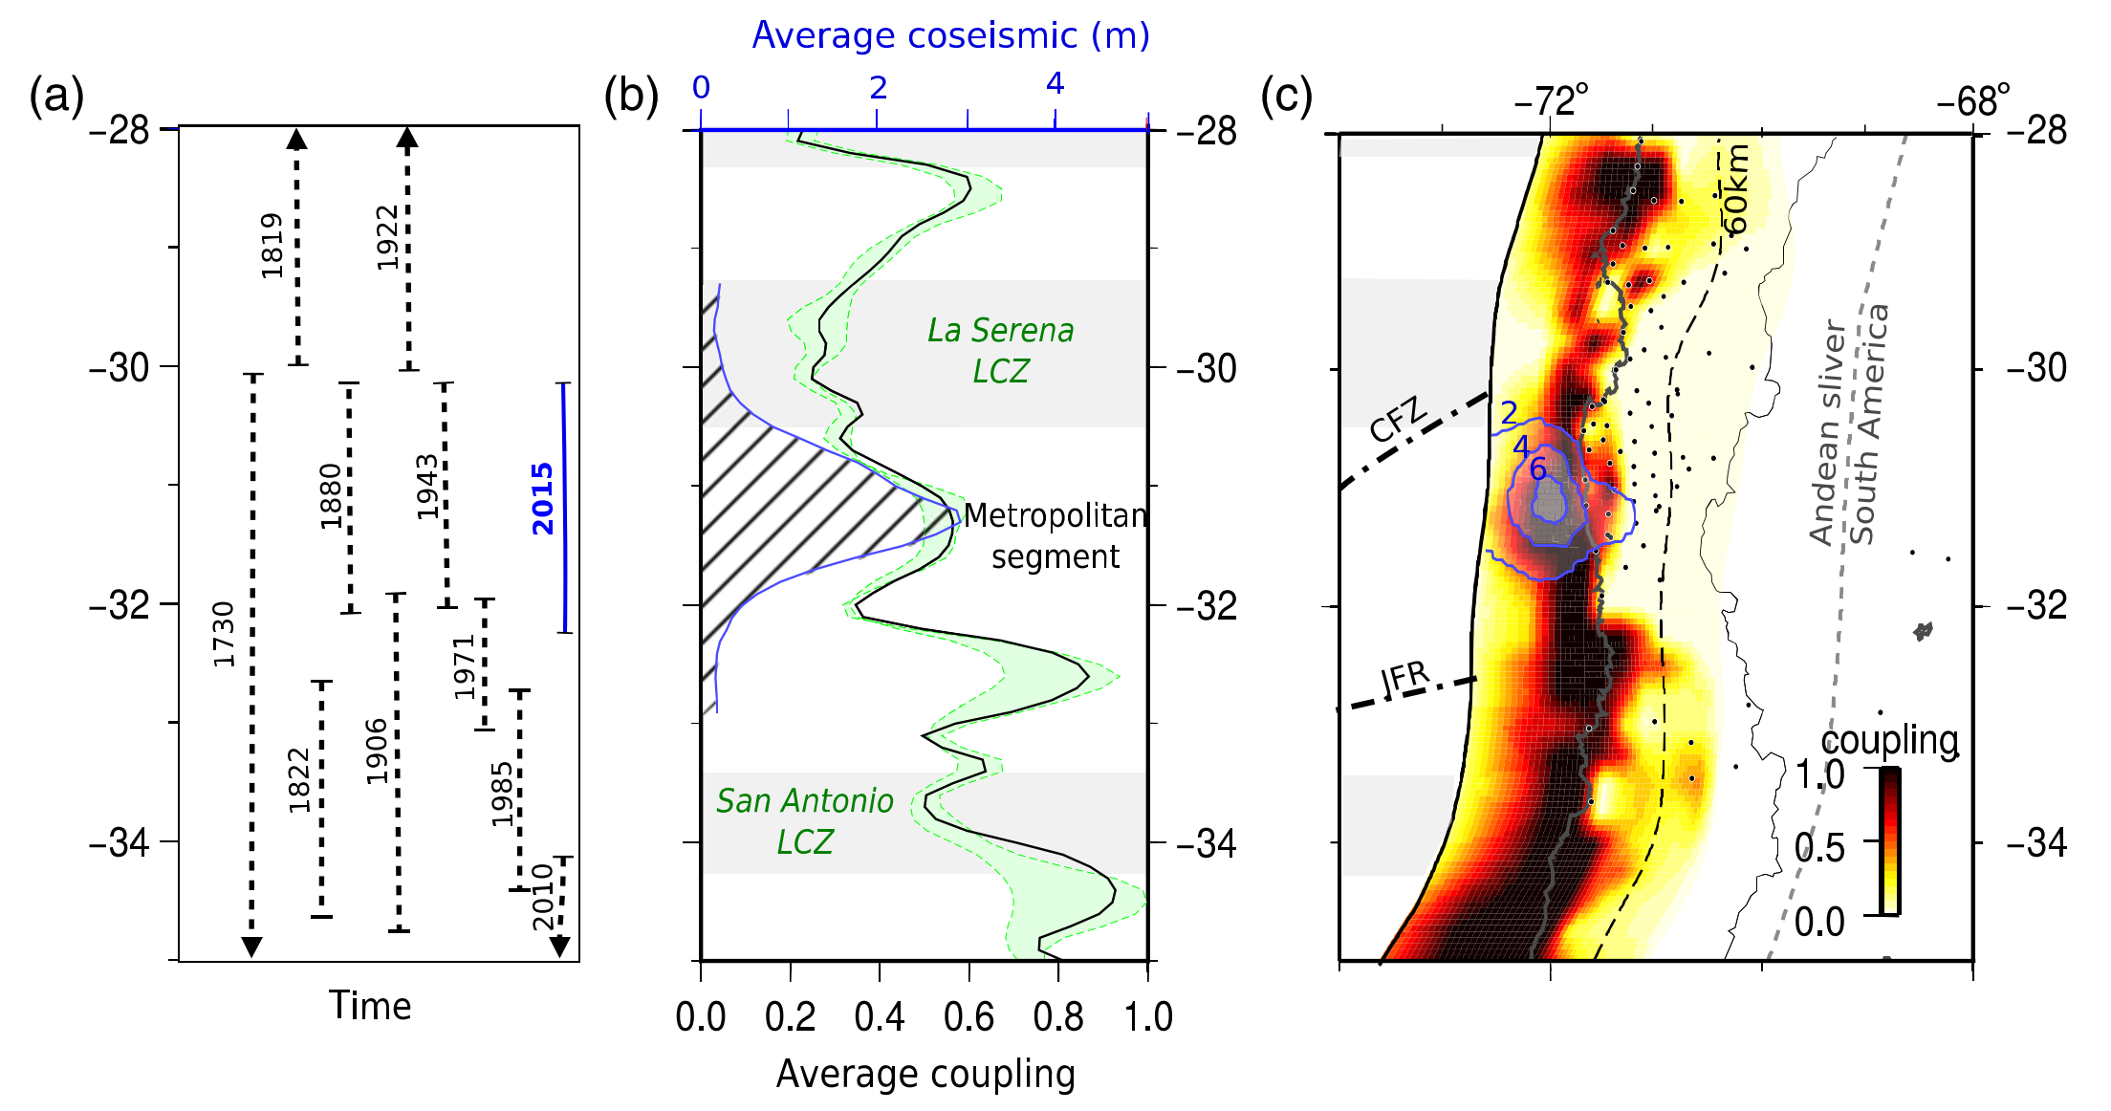
Q1: GPS measurements conducted during the interseismic period showed that only a small portion of the coast between 31.5° S and 31° S was subsiding, suggesting a deepening of the highly coupled zone
Notes:
Figure 2. (a) Lateral extent of historical ruptures inferred in central Chile (Urrutia and Lanza, 1993; Beck et al., 1998; Lomnitz, 2004). (b) Along-strike variations of the average coupling value from the trench to 60 km depth and two alternative models that fit almost equally well with the data (different smoothing parameters, dashed curves). The average coseismic slip amount for the 2015 Illapel earthquake is the dashed area. Both interseismic averaged coupling and averaged coseismic slip curves have been calculated with 0.2°-wide sliding windows. The lower coupling zones (LCZs) are indicated (modified from Métois et al., 2016). (c) Interseismic coupling distribution for central Chile: thin dashed line, 60-km-depth slab contour; dots, position of GPS stations used for the inversion; and contour curves, 2 m coseismic-slip contours for our proposed Illapel slip distribution. The Challenger fracture zone (CFZ) and Juan Fernandez Ridge (JFR) are indicated. The color version of this figure is available only in the electronic edition.

Slide 5
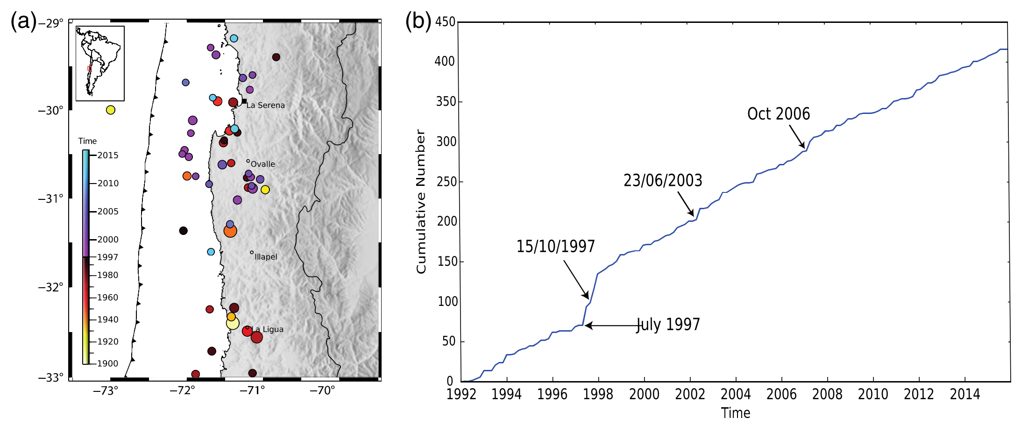
No increase of seismicity before Mainshock.
~M6
~M6
Mw 7.1
Notes:
Figure 3. (a) Seismicity larger than magnitude Mw 6.0 that preceded the main event of 16 September 2015. (b) Cumulative seismicity versus time. The slope of the curve is proportional to the rate of the seismicity of magnitude larger thanMw 4.5 from National Earthquake Information Center (NEIC) catalog. The color version of this figure is available only in the electronic edition.Seismological

Slide 6
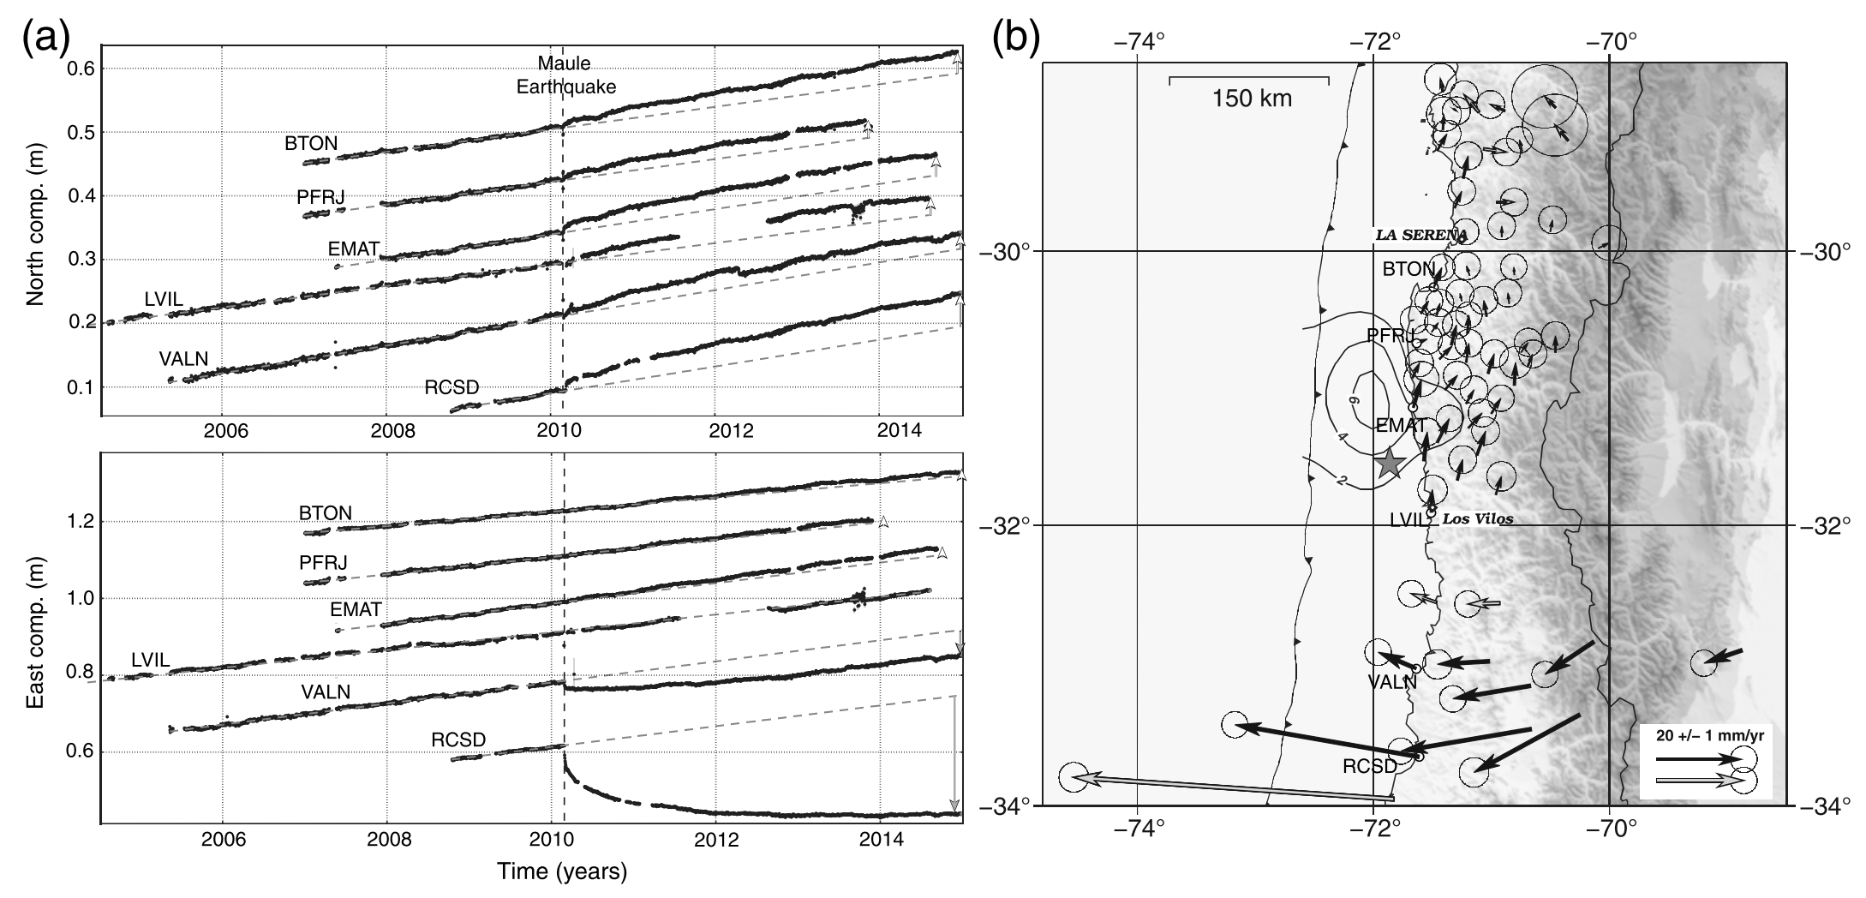
Q2: Similarly to what was observed before the 2011 Tohoku and 2014 Iquique earthquakes (Kato et al.,2012; Ruiz et al., 2014), transient deformation revealed by changing upper-plate velocities was observed in the Illapel zone prior to the seismic rupture. This transient deformation is observed in the continuous GPS time series of stations in the area where a significant change in velocity trend was observed after the 2010 Maule mega-earthquake
Notes:
Figure 4. (a) Time series of coastal GPS permanent stations, ordered by increasing latitude, for the north (top) and the east (bottom) components (comp.). The dotted lines represent the preseismic trends estimated before the Maule earthquake, open arrows highlight the postseismic increase of the trend. (b) Residual velocities (difference between the postseismic [post-2010] and the preseismic [pre-2010] velocities) in mm/yr. cGPS stations represented in (a) are identified by their names and dots. Gray vectors represent less-well-known velocities (few campaign measurements or interpolated pre-2010 velocities). The slip distribution is roughly represented by its contour lines. The star shows the epicenter.

Slide 7
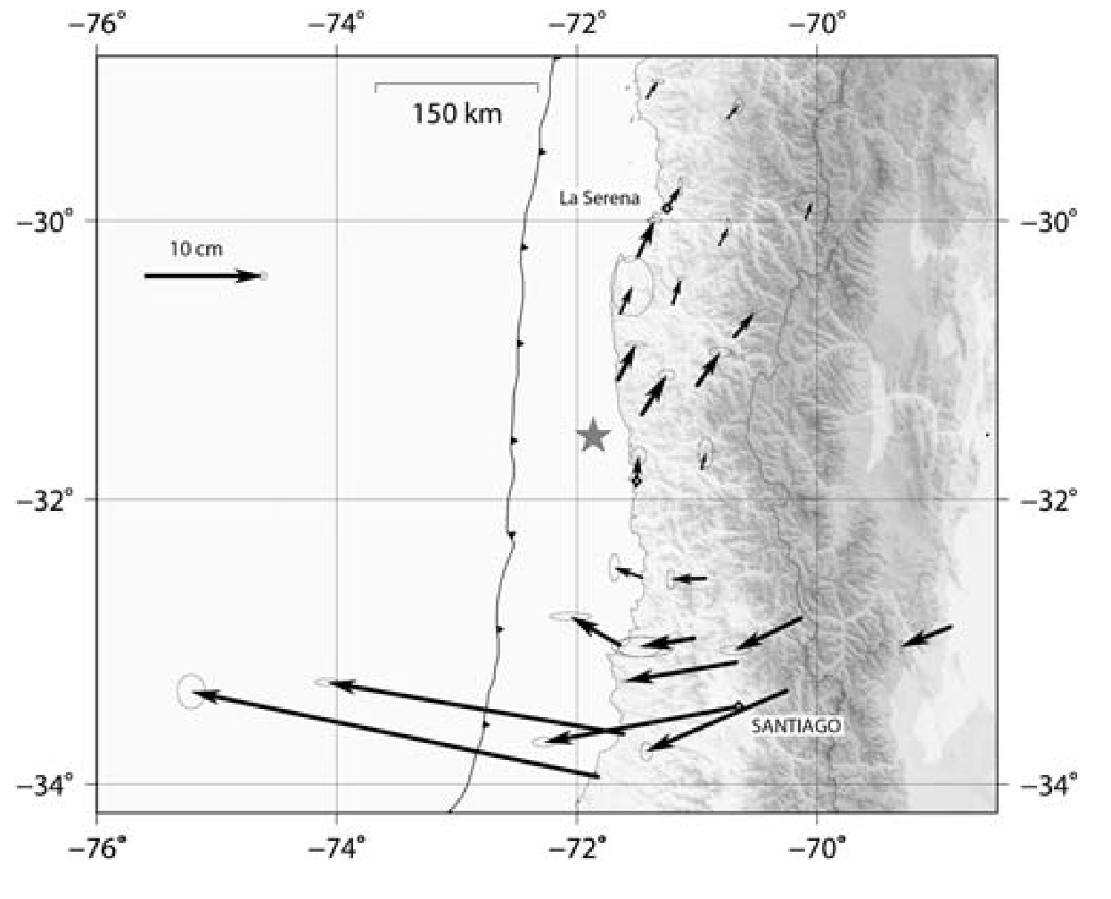
Q3: On the other hand, at both edges of the 2010 rupture, we observed a rotation of the postseismic displacements toward inland directions.
In the Illapel area, this yields northeastern directions, roughly aligned with the preseismic directions, producing an increase close to 15% of upper-plate GPS velocities and thus leading to an increase of strain accumulation in the upper plate.
Notes:
Figure 5. Horizontal cumulative displacements (in centi- meters) over five years (between 2010 and the end of 2014), cor- rected from interseismic trends (modified from Klein et al., 2016).

Slide 8
THE COSEISMIC RUPTURE PROCESS

Slide 9
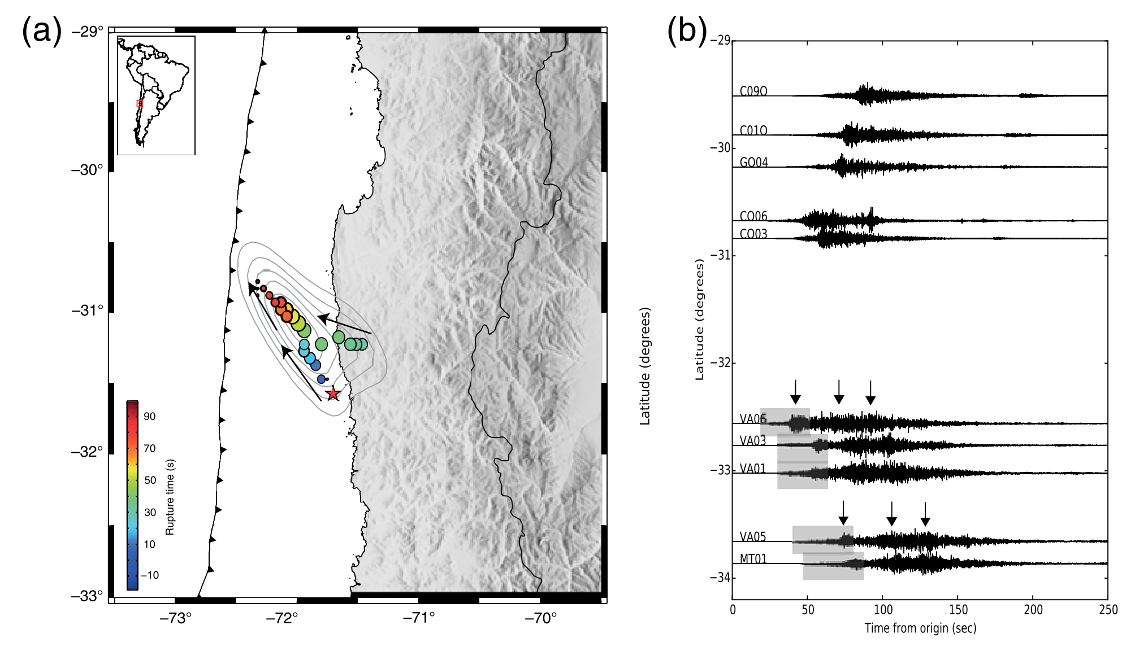
Notes:
Figure 6. (a) Backprojection of the 2015 Illapel mainshock. The dots represent the locations of the sources determined from back- projection of teleseismic P-waves and are coded following the rupture time measured with respect to the hypocentral time. (b) Strong- motion records (east–west components) ordered by latitude: the arrows show the arrivals of different bursts of energy, and the gray rectangles show the seismic waves associated with the first starting phase. (c) Strong-motion records (east–west components) of the Mw 8.3 Illapel earthquake recorded by the Centro Sismológico Nacional (CSN). The color version of this figure is available only in the electronic edition.

Slide 10
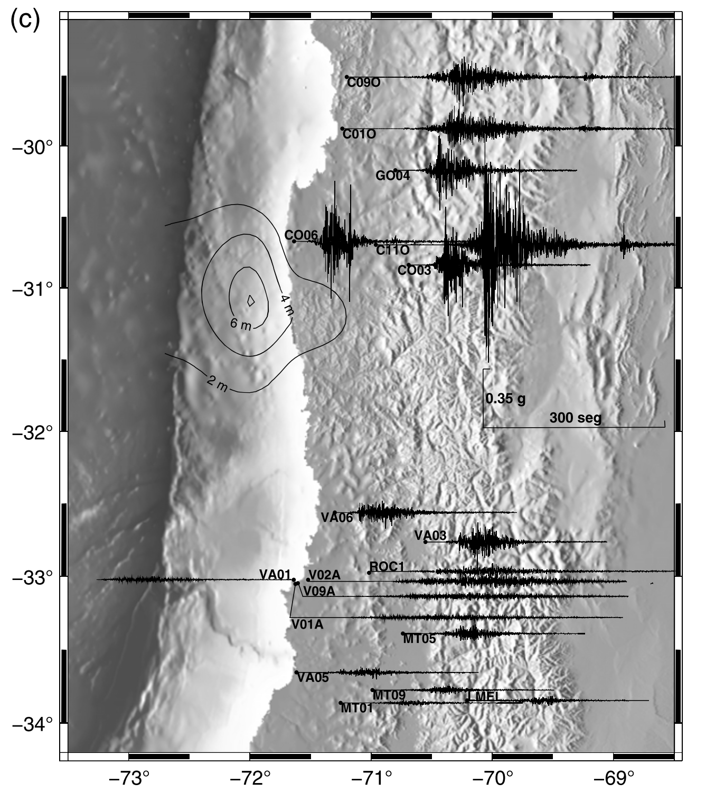
Notes:
Figure 6. (a) Backprojection of the 2015 Illapel mainshock. The dots represent the locations of the sources determined from back- projection of teleseismic P-waves and are coded following the rupture time measured with respect to the hypocentral time. (b) Strong- motion records (east–west components) ordered by latitude: the arrows show the arrivals of different bursts of energy, and the gray rectangles show the seismic waves associated with the first starting phase. (c) Strong-motion records (east–west components) of the Mw 8.3 Illapel earthquake recorded by the Centro Sismológico Nacional (CSN). The color version of this figure is available only in the electronic edition.

Slide 11
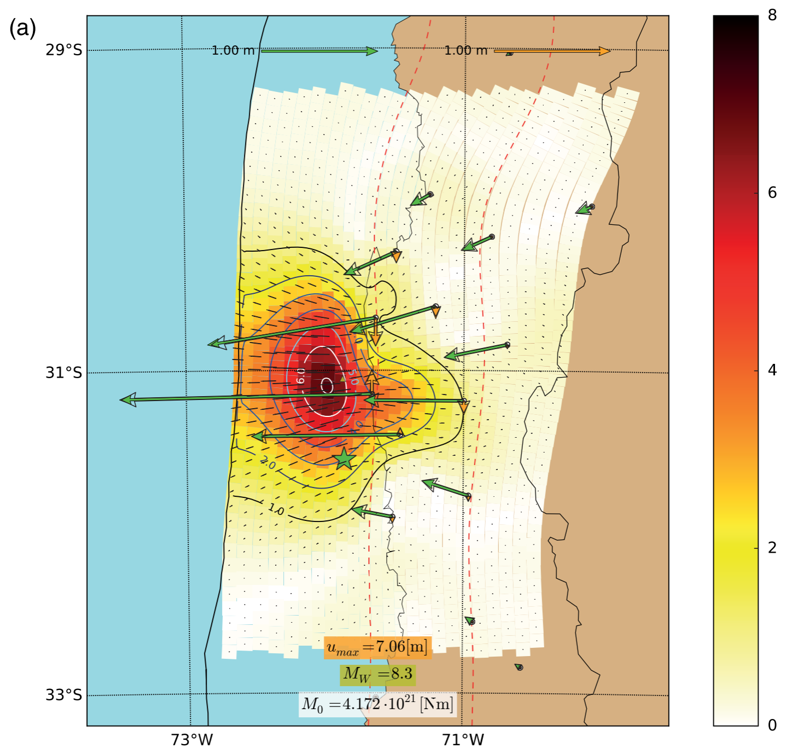

Slide 12
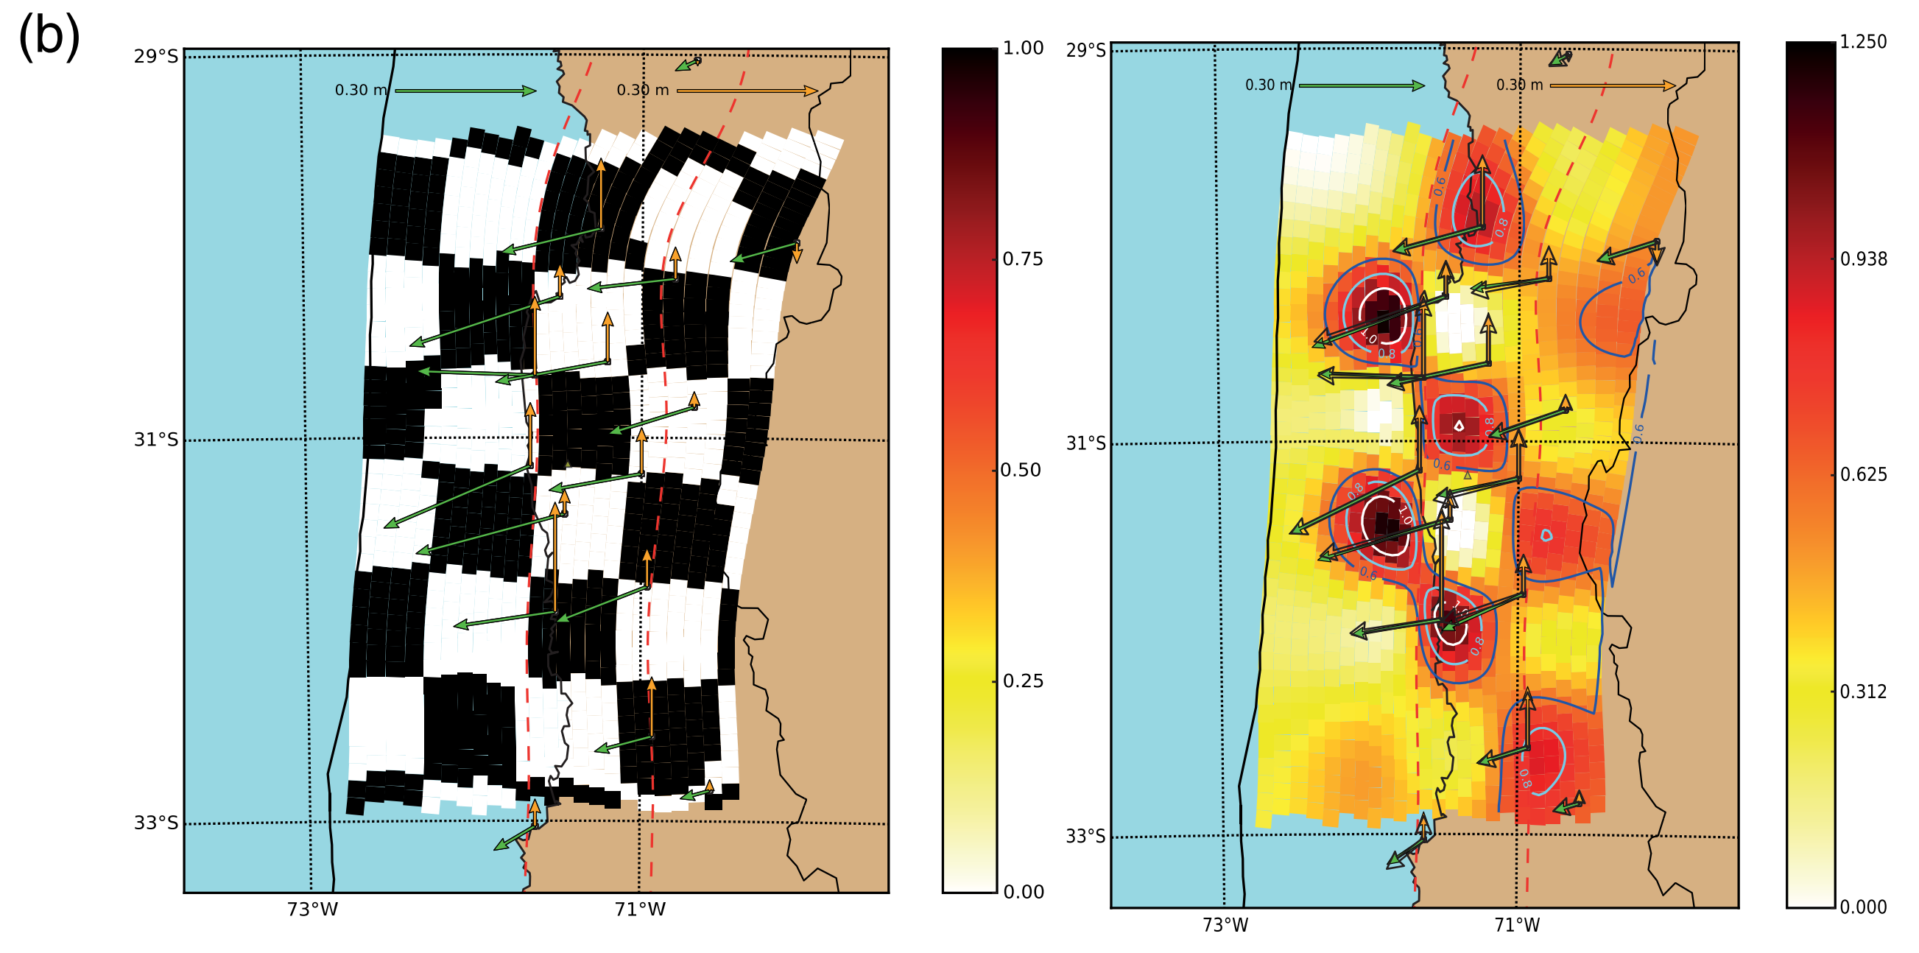
Notes:
Figure 7. Slip distribution of the 2015 Illapel earthquake. (a) Coseismic slip distribution inverted from static GPS displacements (differ- ence between 17 September and 16 September) showing the discretization used in this work. (b) Checkerboard test for the finite source slip inversion using squares of 60 km of side (left figure, input model; right figure, recovered model). The color version of this figure is available only in the electronic edition.Seismological

Slide 13
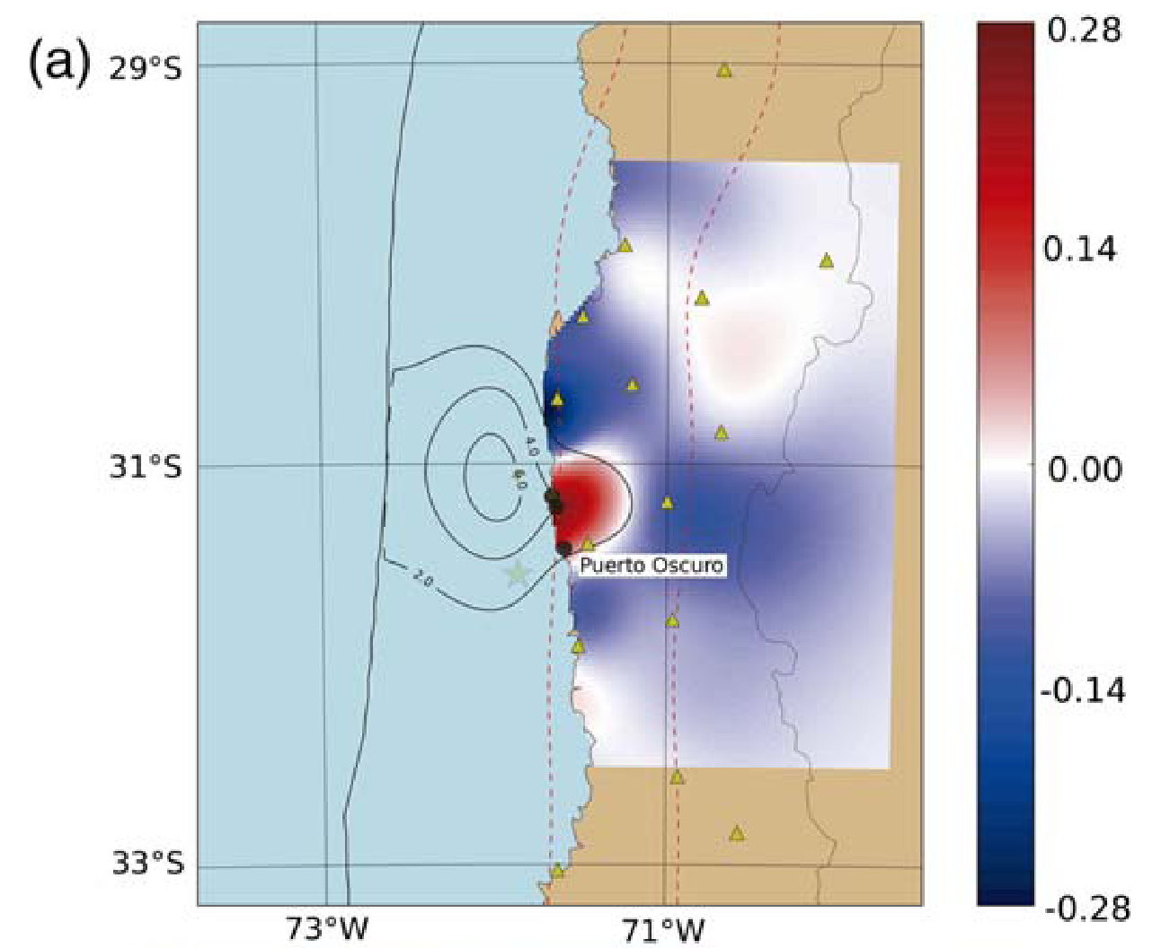
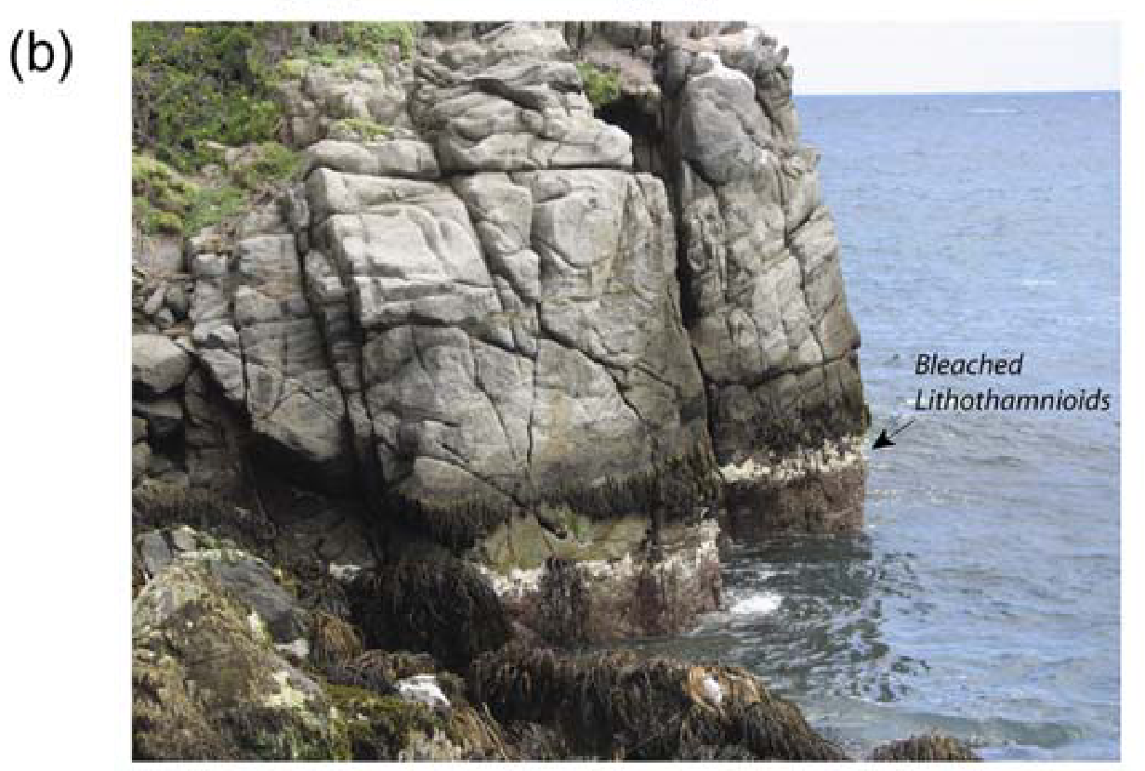
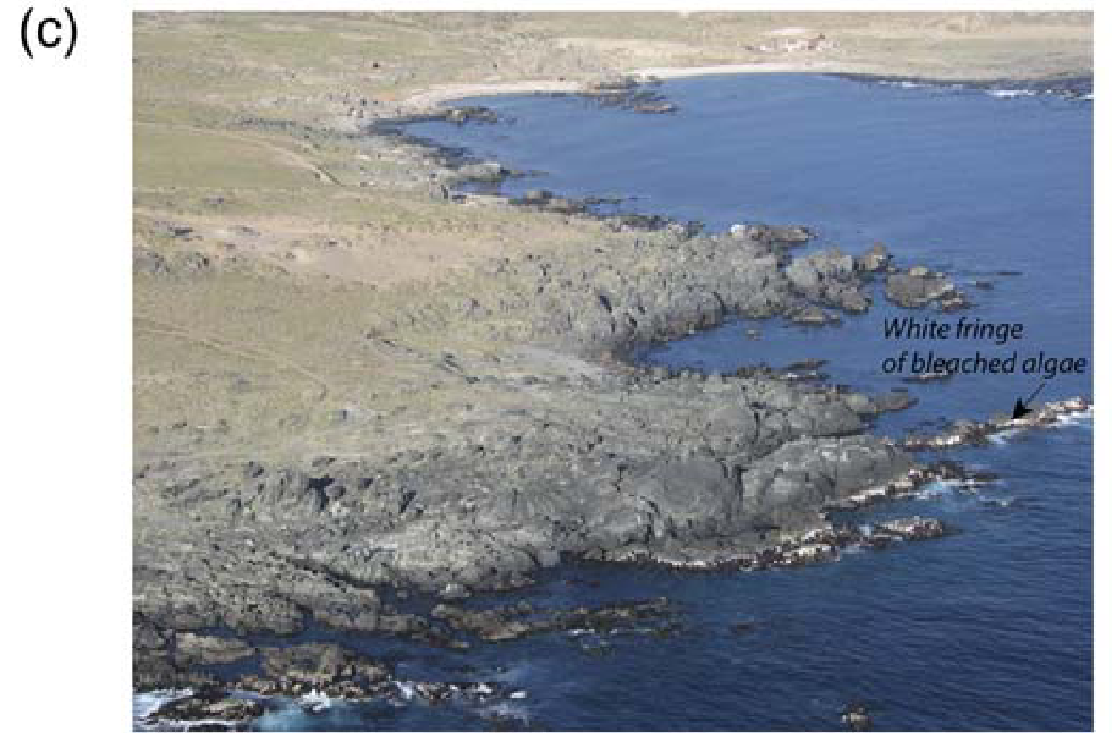
Notes:
Figure 8. Vertical uplift produced by the 2015 Illapel earth- quake. (a) Vertical displacements on the surface predicted by our coseismic slip distribution. Black dots are geological obser- vation of coastal uplift; the triangles are locations of GPS anten- nas. (b) White fringe of bleached lithothamnioids observed at Puerto Oscuro, in front of the epicenter. (c) Aerial view of white fringe of bleached algae observed along the coast to the north of the epicenter. The color version of this figure is available only in the electronic edition.

Slide 14
AFTERSHOCKS

Slide 15
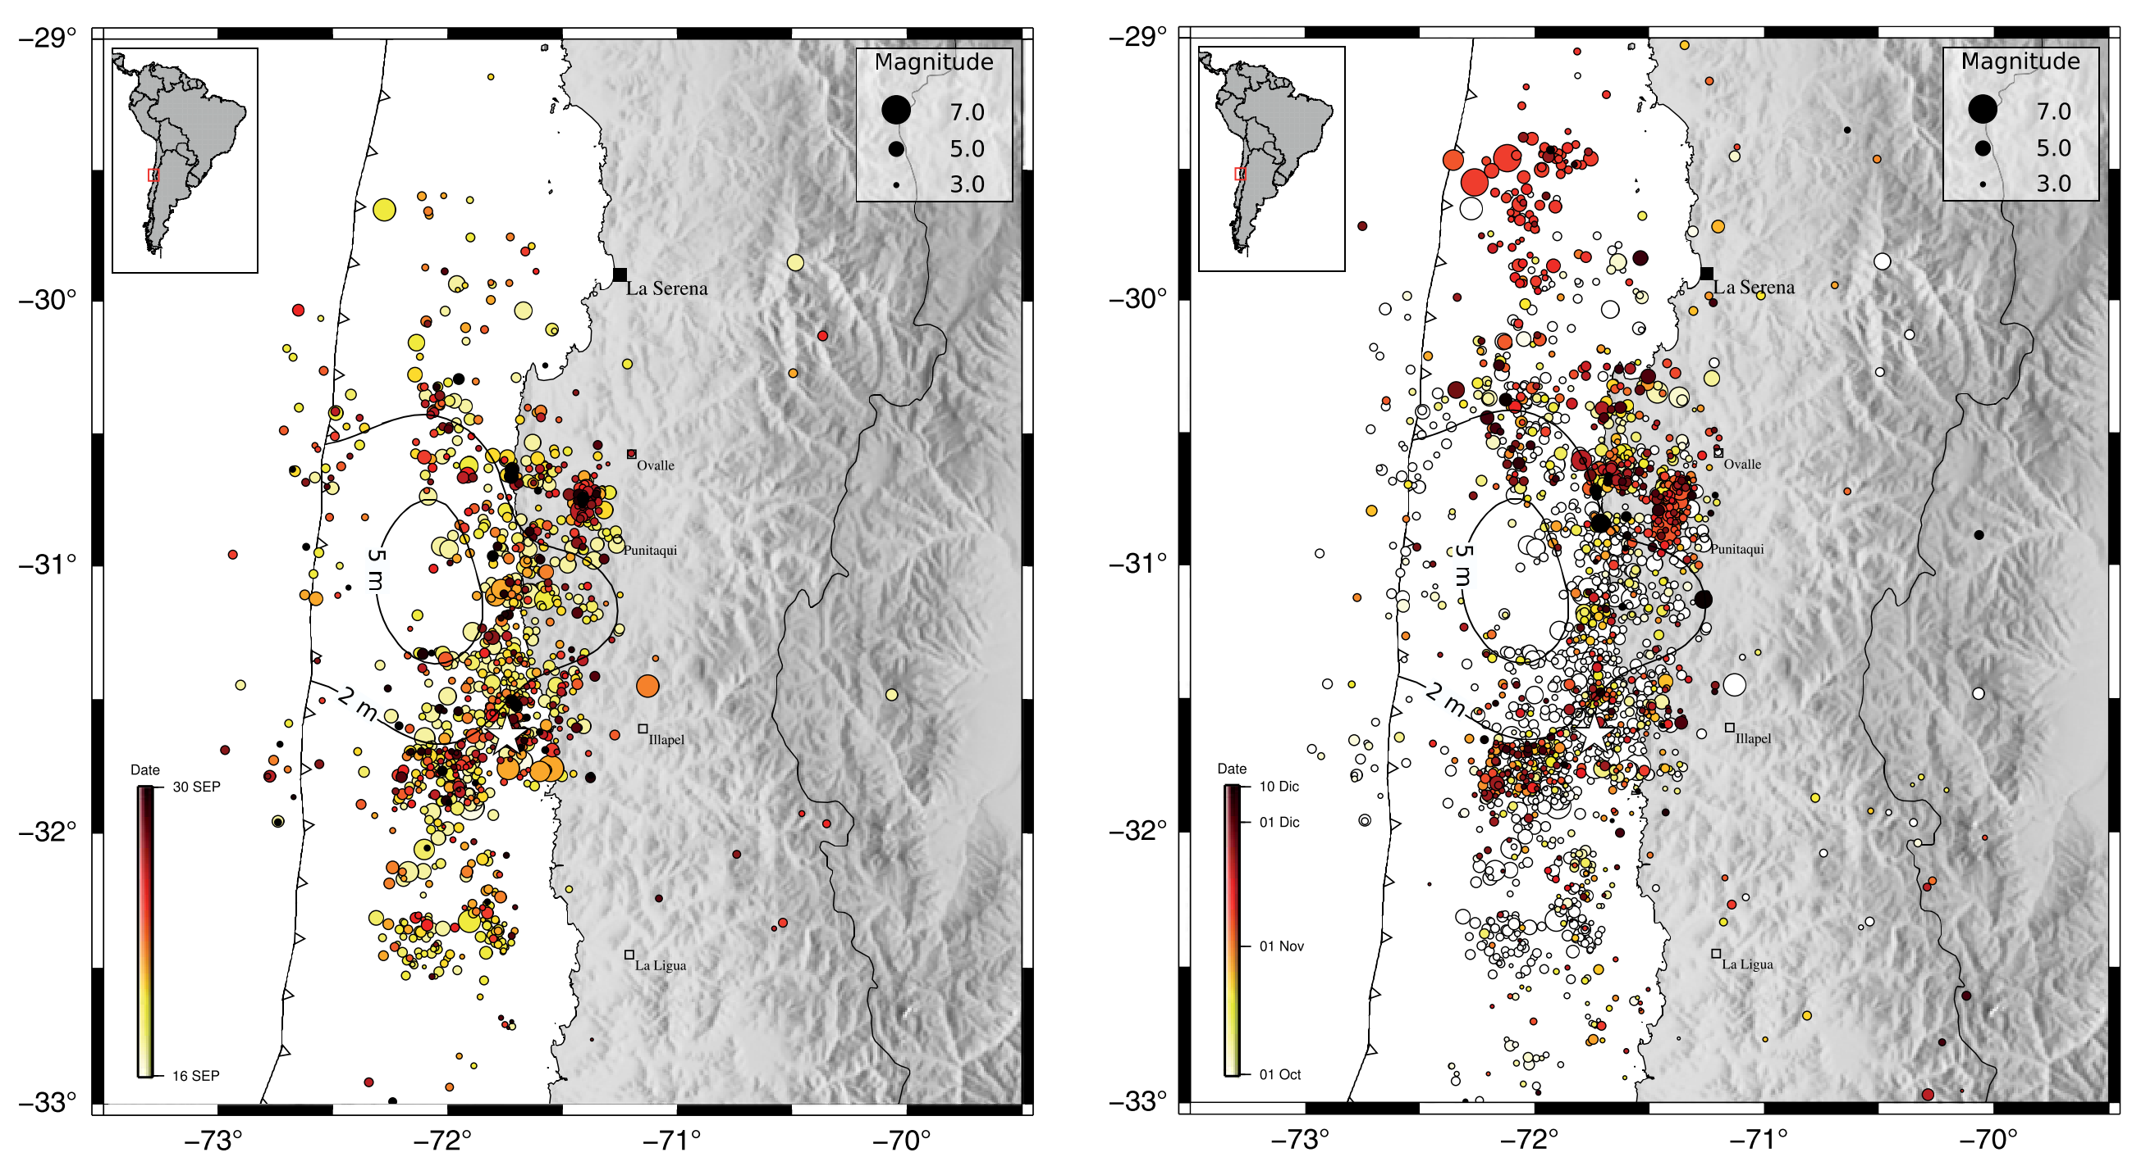
Notes:
Figure 9. Aftershocks of the 2015 Illapel earthquake. (a) Seismicity reported by CSN between 16 September 2015 and 30 September 2015. (b) Seismicity reported from CSN between 1 October 2015 and 10 December 2015. The open circles correspond to the seismicity shown in (a). Contours of the coseismic slip distribution of Figure 7 are plotted in the figures for reference.

Slide 16
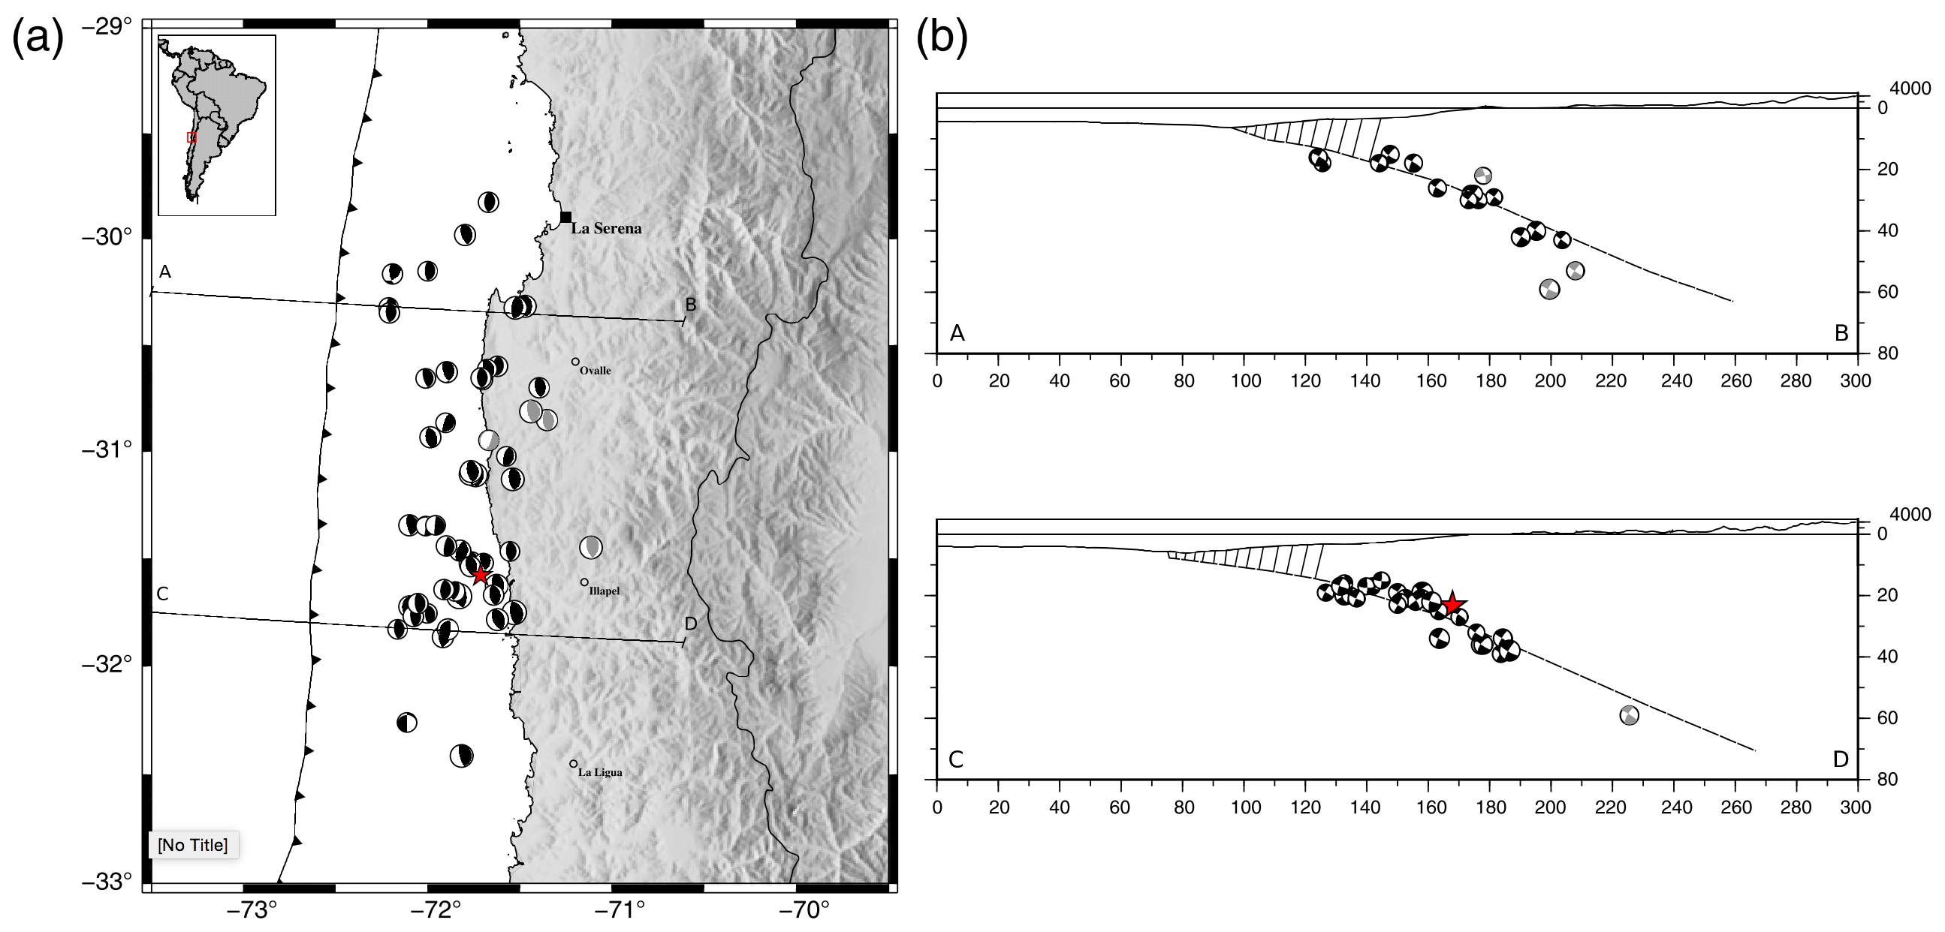
Notes:
Figure 10. Moment tensors of aftershocks of the 2015 Illapel earthquakes. (a) Moment tensor determination for events of magnitude greater than Mw 5.0 occurred between 16 September 2015 and 5 October 2015. The gray focal mechanisms are those interpreted as intraplate intermediate depth or crustal events. (b) Schematic profile of the Nazca plate subduction in the Illapel region based on Hayes et al. (2012) and Contreras-Reyes et al. (2015). The hatched zone is composed of eroded and fractured volcanics (Contreras-Reyes et al., 2015) that could act as an up-dip limit for the seismic rupture. The

Slide 17
More Conclusion
We hypothesize that a possible reason for the triggering of the Illapel earthquake was that the viscoelastic deformation of the asthenosphere after the 2010 mega-earthquake induced a deep transient slow slip that changed the stress conditions in the seismogenic contact of this region
Near the trench, we did not observe large magnitude aftershocks, suggesting that the eroded and fractured volcanic wedge (Contreras-Reyes et al., 2015) could be an up-dip limit of the seismic rupture. The

